Slide 1
Criminal Risk
Analysis
Week 1: Icebreaker + EDA Intro
Fall 25

Slide 2


Meet your Leads! - Will McKanna
Hometown: Rockford, MI
Major: DS and Statistics - LSA
Year: Sophomore
Ask me about: Studying abroad in Iceland, crocheting, trombone, Michigan and Detroit football

Slide 3
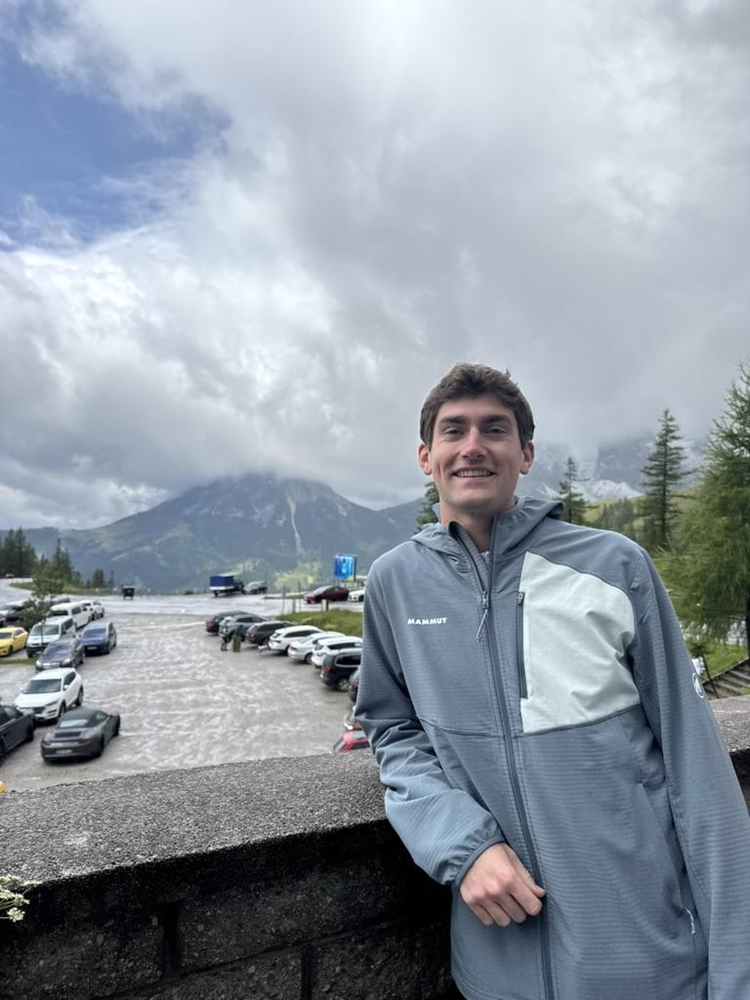
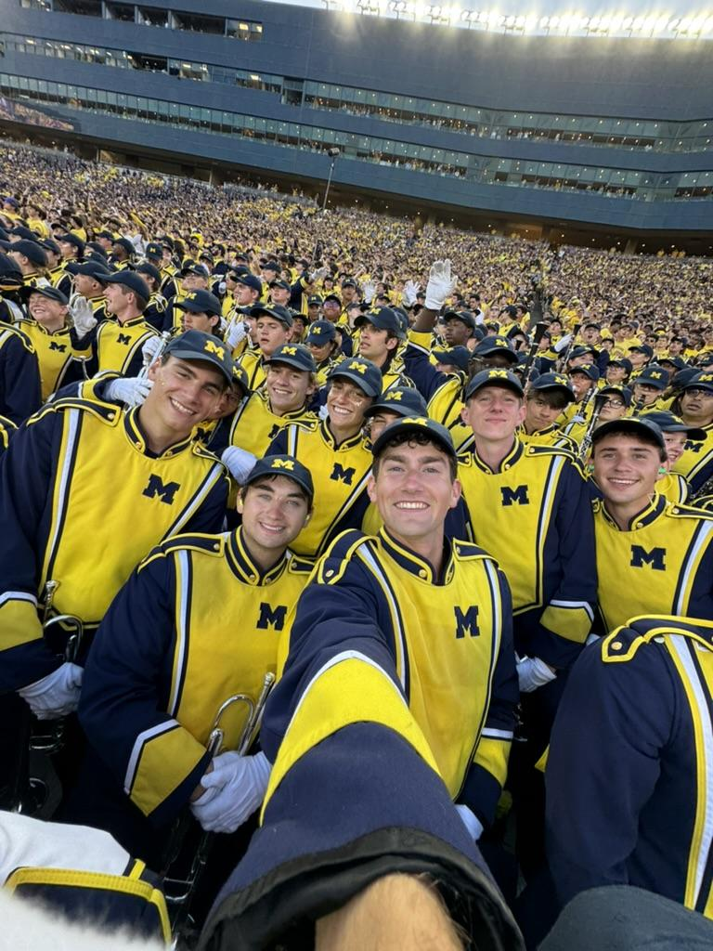
Meet your Leads! - Ryan Zimmel
Hometown: Fargo, ND
Major: Information Analysis
Minors: Data Science + Business
Year: Junior
Ask me about: A2 Coffee shops, Marching Band, School of Information, Music + Concerts

Slide 4
Session #1 Agenda
Fun Icebreaker
Expectations
Intro to COMPAS
Project Overview
Practice Time!

Slide 5
Icebreaker Bingo!
 | A | B | C | D | E
1 | I have taken EECS 280 | Slept overnight at a UofM non dorm building | I can whistle | I’m part of another CS/DS club | I get the supreme slice @ Joe’s
2 | I’m a member of MAISI | I have season tickets to Michigan Football | Touched grass this summer (3+ outdoor activities) | I’m a Data Science major | I know the capital of Mongolia
3 | I play a sport | I’m a non CS/DS major | I’m a part of MDST | I pay for guac at chipotle | I live on North
4 | I’m a Computer Science major | Took Math 215 at Michigan (WCC >>) | I play an instrument | I’ve taken a formal statistics class (HS/college) | I’ve visited the Upper Peninsula
5 | Gotten <50% on a Michigan exam | Skipped < half of my lectures last week | I live on Central | I’ve customized my VSCode | Read 3+ books this year

Slide 6
Expectations
Be responsible and show up!
Enjoy working collaboratively
Want to learn more about data science and analysis
Hands-on practice (ew lecture based learning)
Gain coding experience, no matter your learning pace
Notes:
Angela

Slide 7
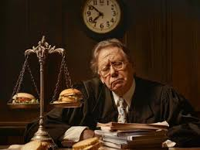
Why use risk assessment algorithms?
Risk assessment algorithm: algorithm used in the criminal justice system to predict the chance of an event: not showing up to trial, reoffending
Replace human labor in making decisions about risk
More importantly, replace the personal, potentially biased nature of human judgement with an unbiased factual decision.
“Hungry judge effect”
Be more “objective” in choosing who goes to jail
Idea that statistics is always better than human judgment
Notes:
Lucas

Slide 8
History of Risk Assessment Algorithms in U.S. Courts
First risk assessment algorithm (1930): UIUC, Northwestern, and University of Chicago all collaborate to create a statistical model to assess “rehability” to see which criminals should go on parole
Summary sheet: factor linked with percentage
1990-2000: computer boom, risk assessment algorithms = common practice
COMPAS is one of the biggest ones
Notes:
Lucas

Slide 9

What is COMPAS, and what is it used for?
The COMPAS (Correctional Offender Management Profiling for Alternative Sanctions) algorithm is a risk assessment algorithm that predicts whether a criminal will recidivate in the next 1-3 years
It’s used in different stages of the criminal sentencing process. Broward County - Pretrial Release (bail)
Created by Northpointe. (Now called Equivant)
Notes:
Angela

Slide 10
How does COMPAS work?
Weighted linear combination of a set of 137 questions
“A hungry person has a right to steal”
“Was one of your parents ever sent to jail or prison?”
“Do you have an alias (do you sometimes call yourself by another name)”
No questions directly mention race.
Additional questions mention job and education.
Proprietary, ‘Black-Box’ model
Scoring: Violent/Non-Violent, 1-10
Notes:
Lucas

Slide 11
Racial Bias in Algorithmic Risk Assessment
Context: Brisha Borden (18, Black) and Vernon Prater (41, White) committed similar petty crimes.
Borden’s Incident: Stole a child’s bike and scooter, valued at $80; had a minor juvenile record.
Prater’s Incident: Shoplifted tools worth $86.35; had a history of armed robbery with previous prison time.
Algorithmic Risk Assessment:
Borden was rated as high risk for reoffending. (8)
Prater was rated as low risk for reoffending. (3)
Outcome: The algorithm’s prediction was incorrect:
Borden: No new charges after two years.
Prater: Convicted again, serving an 8-year sentence for burglary.
Notes:
Angela

Slide 12
Who is ProPublica and why did they choose to investigate
Independent, nonprofit newsroom founded in 2007-2008.
Mission: Expose abuses of power through investigative journalism.
COMPAS lacked independent studies on its accuracy and fairness
Concerns about bias injected into the judicial process due to risk scores.
Ensure fairness in the criminal justice system by scrutinizing widely used tools like COMPAS.
Notes:
Angela

Slide 13
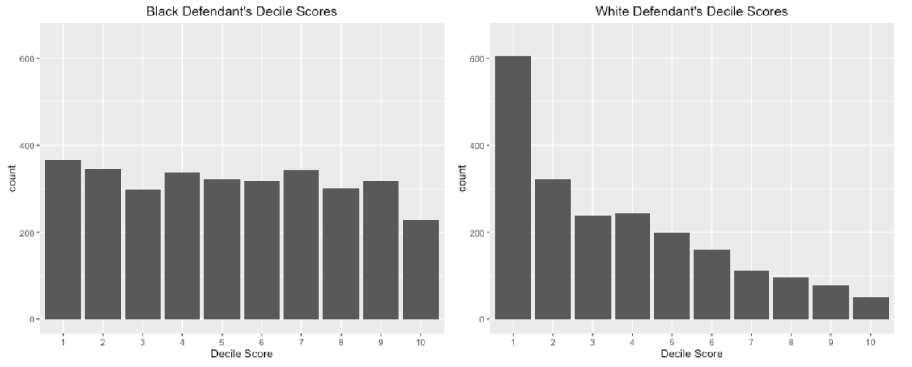
What did ProPublica find
Upon doing exploratory data analysis on a dataset of COMPAS risk scores:
Is this evidence of bias?
Notes:
Lucas

Slide 14
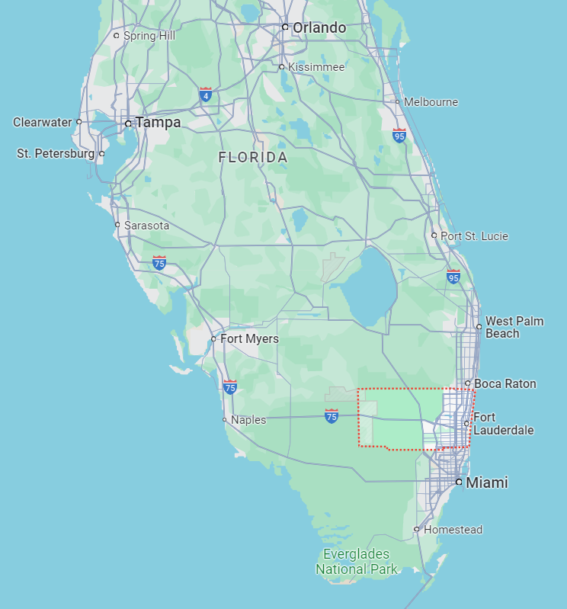
What did ProPublica find
These graphs alone are not evidence of bias
Another way to assess the bias of the model: cross-reference recidivism risk scores with REAL recidivism
Look at criminal histories of Broward County, FL residents and compare them with COMPAS scores
Notes:
Lucas

Slide 15
What did ProPublica find
False positives: black defendants who did not recidivate in two years were nearly twice as likely to be misclassified as higher risk compared to white defendants (45% vs 23%)
False negatives: white defendants who reoffended in two years were nearly twice as likely to be misclassified as lower risk compared to black defendants (48% vs 28%)
Gender bias - a high risk woman has a lower chance of recidivating than a male counterpart
Even disregarding bias across races, COMPAS correctly predicted an offender’s recidivism only 61 percent of the time!
Notes:
Angela

Slide 16
What is Fairness as it relates to ai safety
Fairness is complicated because no algorithm is accurate, especially if its outputs are associated with inputs with different traits.
3 different definitions of Fairness:
Statistical Parity: an algorithm makes positive decisions at an equal rate across protected groups
Equalized odds: False positive & False negative rate are equal between protected groups
Calibration: Prediction matches the real outcome at the same rate across groups
Which of the following fairness definition does COMPAS fail?
Notes:
Lucas

Slide 17
Other algorithms that are unfair
Resume screening algorithm (Amazon)
Amazon’s resume screening algorithm ranked applicants based on historical trends
Women had a lower chance of getting through
It penalized resumes that included the word "women's"
Downgraded graduates of two all-women's colleges
Project was eventually scrapped
Statistical Parity test
Notes:
Angela

Slide 18
Critical Issues
Inaccuracy:
Only 20% of those predicted to commit violent crimes did so.
When all crimes were considered, 61% of those predicted to reoffend did so within two years.
Racial Disparities:
Black defendants are nearly twice as likely to be falsely labeled as high risk compared to white defendants.
White defendants are more often labeled as low risk.
Notes:
Angela
The risk assessment algorithm showed racial bias, predicting higher risk for the Black individual despite a less severe criminal history.

Slide 19
Overview of techniques/libraries we will use
Programming Languages: Python
Libraries: pandas, NumPy, Scikit (learn and survival), seaborn (statistical data visualization), SQLite (portable database resource)
Tools: Google Colab
Notes:
Lucas

Slide 20
What will you get out of this project
Gain awareness of AI ethics, safety, and fairness
Practice Python, pandas, and different statistical tests
Project Expo and final presentation experience for personal and professional development
Notes:
Angela

Slide 21
Project timeline
Week 1: Icebreaker/EDA intro (programming/python basics)
Week 2: EDA/data cleaning
Week 3: Error analysis
Week 4: Logistic Regression
Week 5: Cox Proportional Hazards
Week 6: Intro to SQLite (visualizations + basics)
Week 7: Kaplan Meier Curves (more sql exercises)
Week 8: Work Session
Week 9: Work Session
Week 10: Work Session
Notes:
Lucas

Slide 22
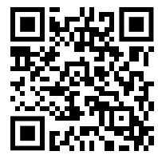
Survey

Slide 23
Time to Practice!
Using the data collected from the Google Form you just completed, you’ll practice some foundational pandas skills during this session.
Find the notebook in Lucas’s github
Split into teams of 2-3!
Please introduce yourself (if you haven’t already) – name, where you are from, year, intended major.
Share a quick fun fact about yourself (hobbies, interests, etc).
https://pandas.pydata.org/Pandas_Cheat_Sheet.pdf

Slide 24
Thank you!
Any questions so far?

Slide 25
Define key research questions and objectives.
Come up with research questions (fill this out with them ig, ex.’s if stuck: )
Evaluate predictive accuracy
Investigate bias and fairness: identify and quantify and racial or demographic biases in the COMPAS risk scores.
Provide insights into how these biases may impact sentencing and parole decisions
Perform statistical analysis using logistic regression, survival analysis, and other statistical methods
Promote ethical use of algorithms, ensuring fairness and transparency in algorithmic decision-making

